Slide 1
March 14 2015 9:26:53
WILL BE EPIC
Why?
3.141592653 = $π$
What will you be doing????

Slide 2
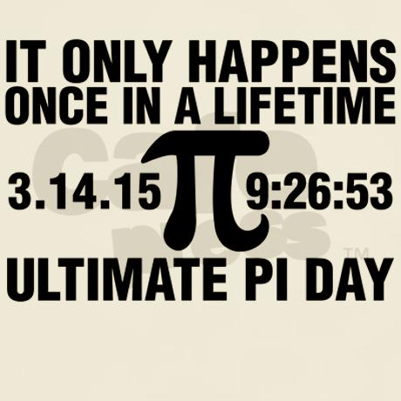
HOW WILL YOU CELEBRATE?

Slide 3
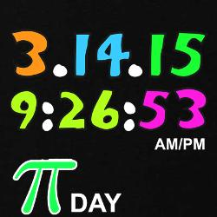
The day we’ve all been waiting for!
The day we’ve all been waiting for!
The day we’ve all been waiting for!
The day we’ve all been waiting for!

Slide 4
Let your inner geek out!
Let your inner geek out!
Let your inner geek out!
Let your inner geek out!

Slide 5
